Slide 1
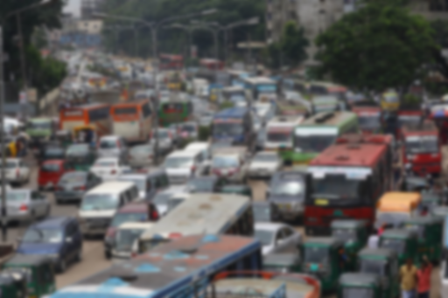
SilentSignal
A Noiseless Vehicle Horn System
Proposed to:
Prof. Dr. Md. Shamim Akhter,
Professor, AUST CSE.
Lomat Haider Chowdhury
Lecturer, AUST CSE.
Raiyan Jahangir
Lecturer, AUST CSE.
Proposed By-
Abrar Khan Alvi 20210104016(A1)
Fahari Alam Rashed 20210104017(A1)
H.M. Ziyad 20210104023(A1)
Afia Fahmida 20210104032(A2)

Slide 2
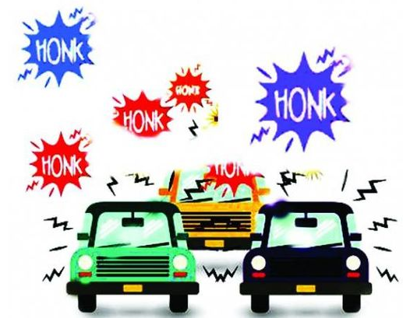
Contents
Main Concept
Required Components
Implementation
Multidisciplinary
Design Data Sheet
Challenges
Estimated Budget
Social and Economical Impacts

Slide 3


The Concept
Internalized Communication between vehicles
Selective signaling
Reduced Honking Frequency
Maintaining safety norms

Slide 4
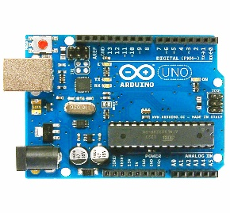
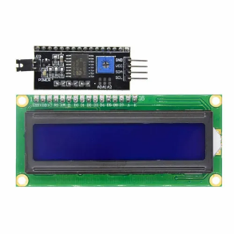
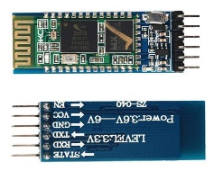
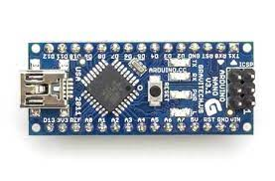
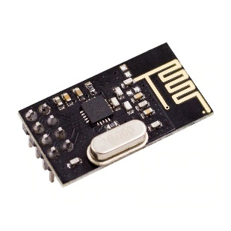
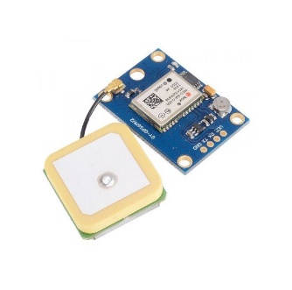
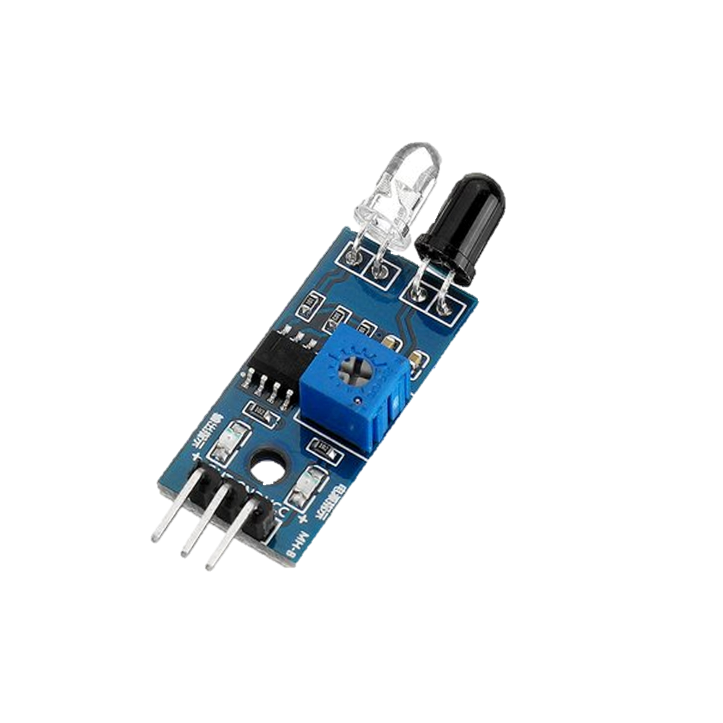
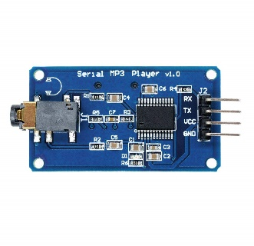
Required Components
Arduino Boards
16X2 Serial LCD Modules
Bluetooth Modules
NRF24L01+ Modules
Neo-6M GPS Modulo
Serial mp3 Module
IR Sensor

Slide 5
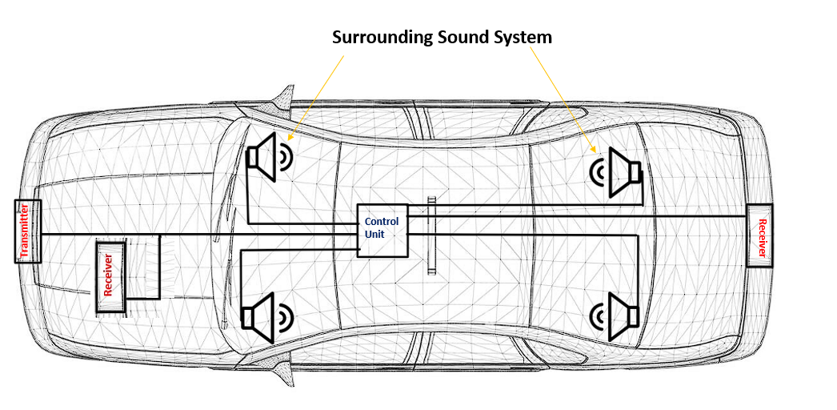
Implementation Block Design

Slide 6
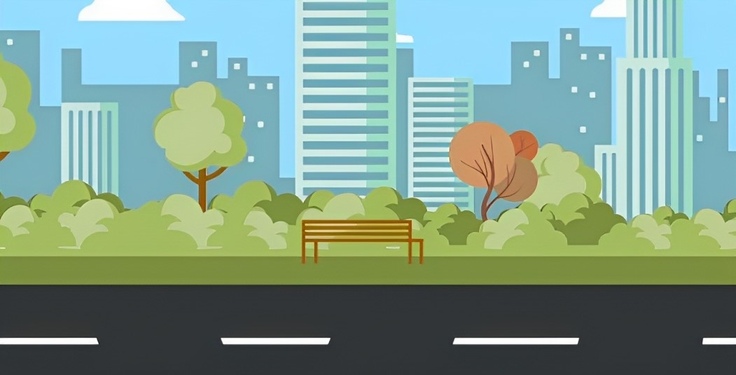




Slide 7



Multidisciplinary Contribution
Electrical and Electronic Concepts:
Maintenance of voltage and current flows
Compatible electronics
Softwares:
Arduino IDE
Android Studio, VS Studio
Programming languages: Arduino language, Flutter, C++
Mathematical Concepts:
Distance calculation using longitude and latitude parameter
Google Map API

Slide 8
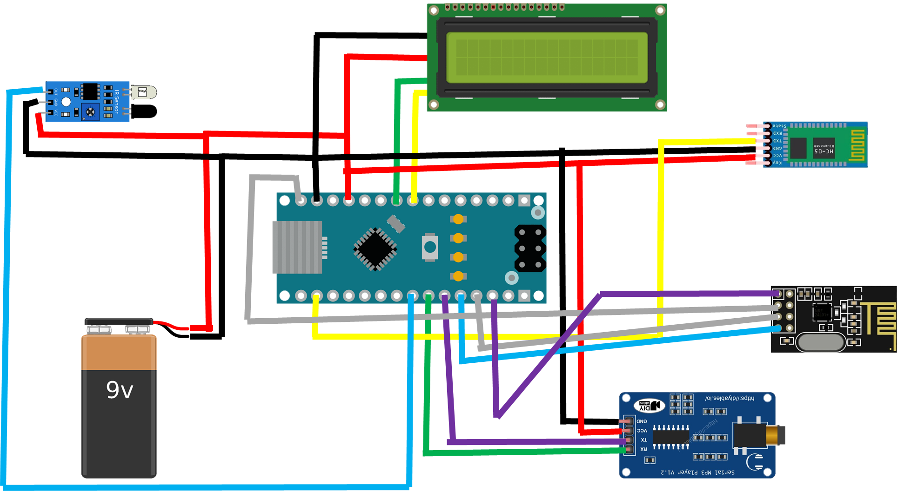
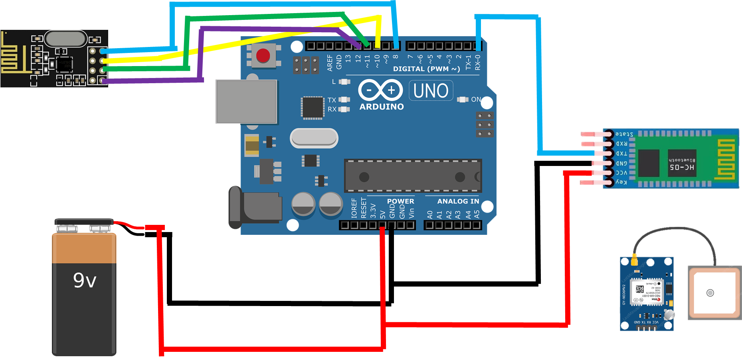
Implementation Data Sheet
Sender
Reciever

Slide 9
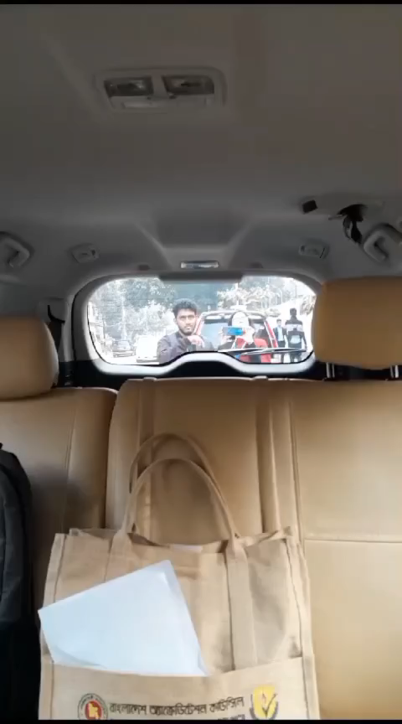

Slide 10



Challenges
Problem: Addressing the frequency wave
Solution: Implementation of GPS Module

Slide 11
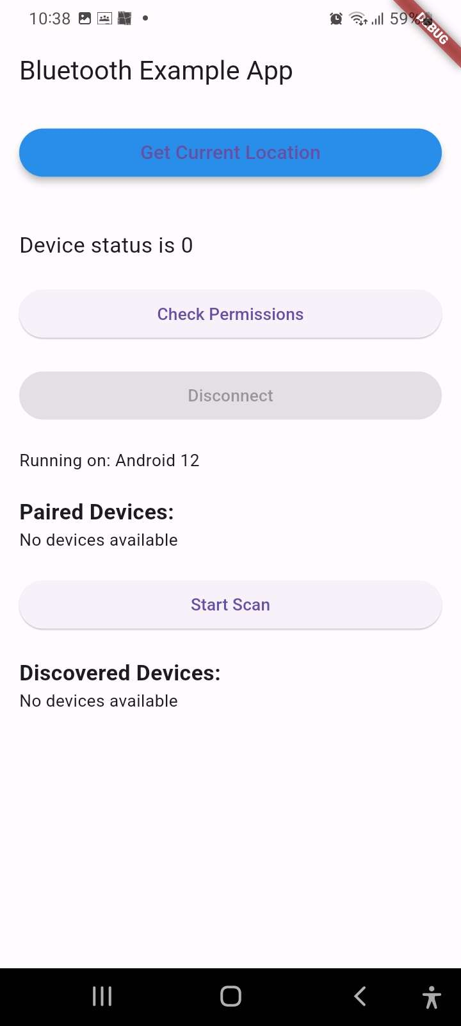
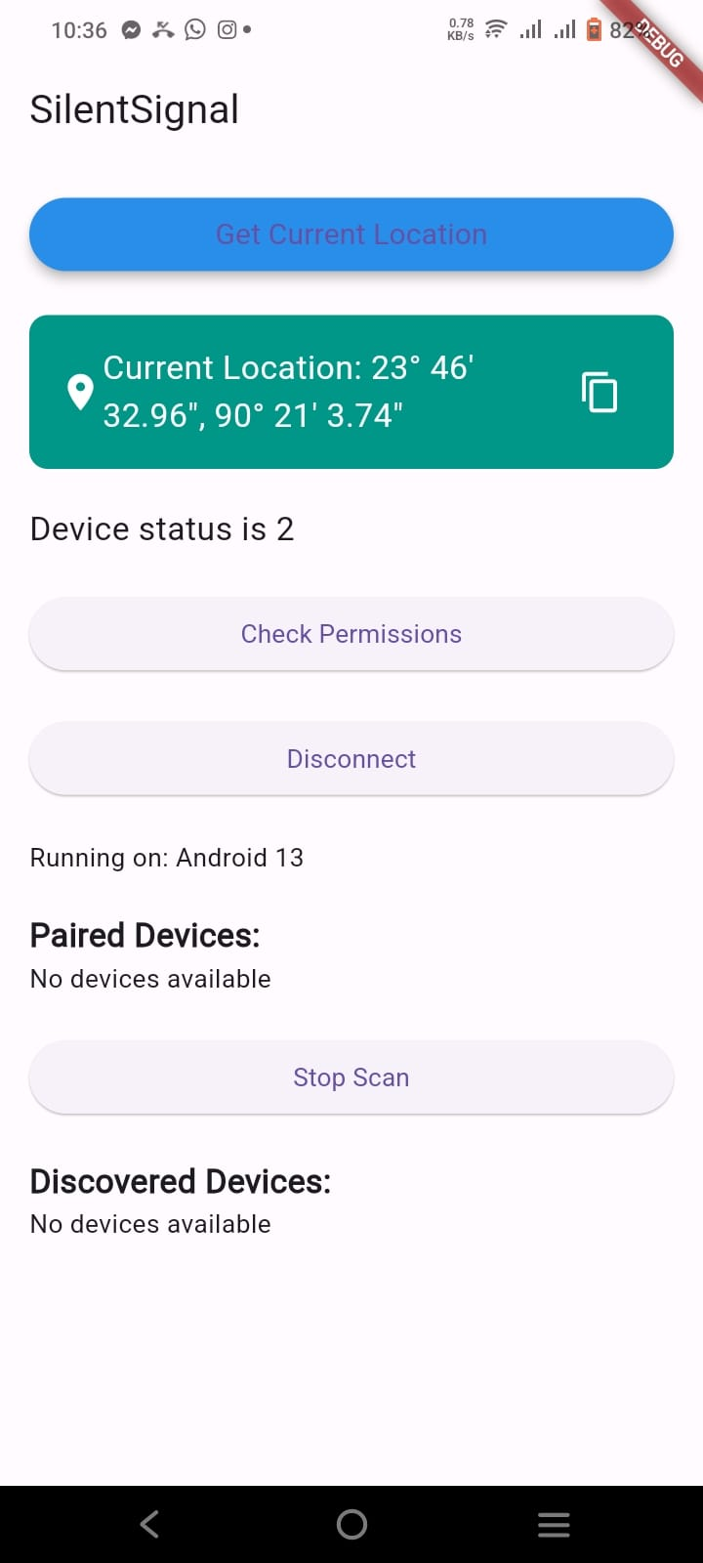
Challenges
Problem: Implementation of GPS Module
Solution: Use of an external application software that measures latitude and longitude

Slide 12
Estimated Budget
Components | Price | Quantity
Arduino Uno | BDT 840 | 1
Arduino Nano | BDT 600 | 1
16x2 Serial LCD Module | BDT 220 | 2
NRF24L01+ Transceiver Module | BDT 199 | 2
Serial mp3 Module | BDT 199 | 2
Neo-6M GPS Module | BDT 500 | 2
Batteries & Jumper wires | BDT 1000 | As required
Total Budget: BDT 4676
Updated Budget: BDT 3236(without GPS modules and components already present in a vehicle)

Slide 13
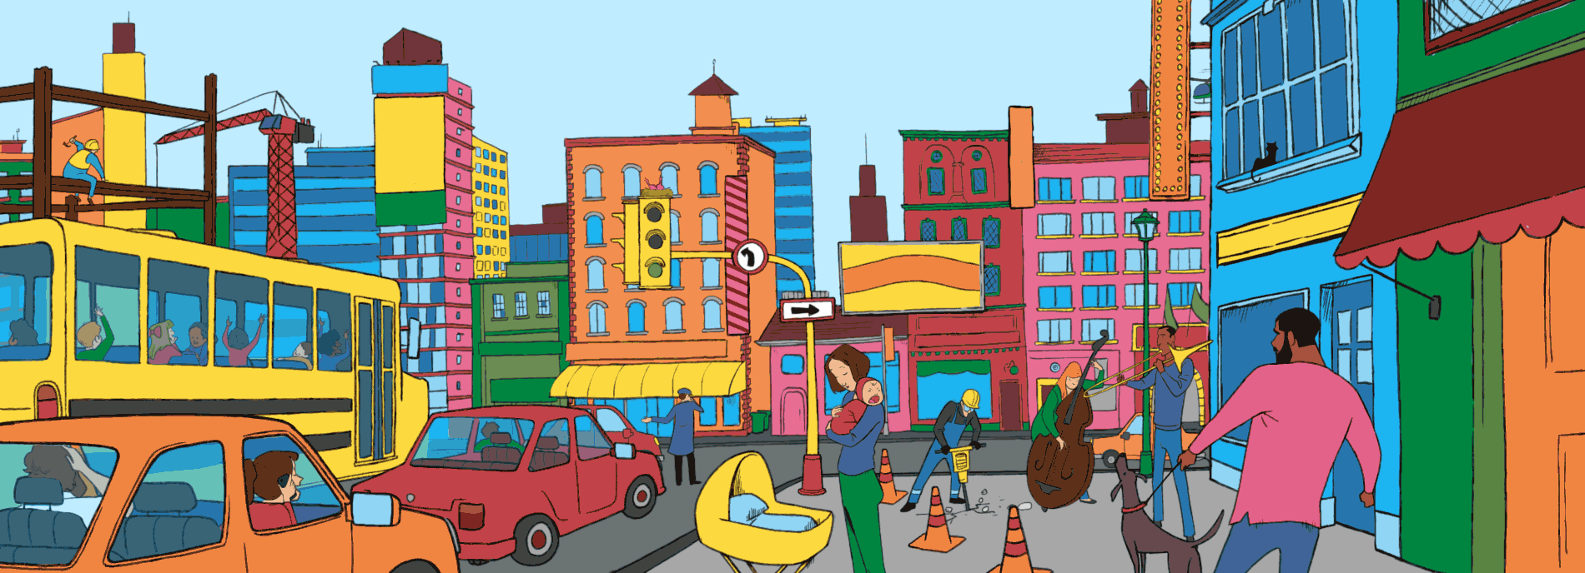
Impacts
Social Impacts:
Reduction of noise pollution
Eradication of distractions on roads
More concentrated driving
More digitalized society

Slide 14

Impacts
Economic Impacts:
Cheap system with more facilities
Employment opportunities for engineers
Collaboration with automobile companies
Open market for multidisciplinary collaboration

Slide 15
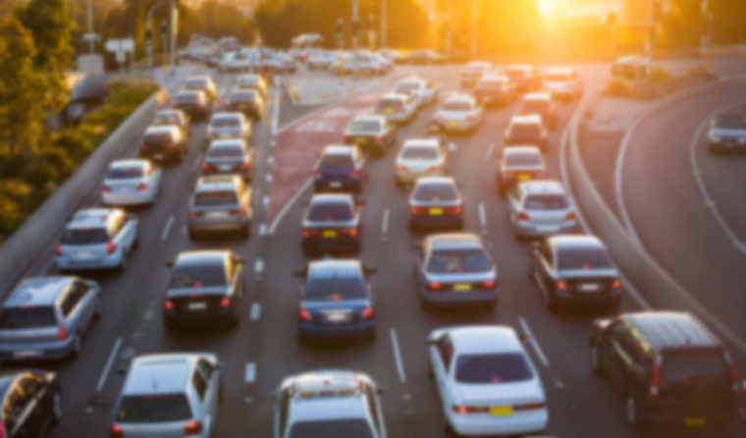
Thank You
Any Questions?

